Slide 1
Capital Bikeshare
Dataphilers

Slide 2
Introduction
Capital Bikeshare(CapBi) is a bicycle sharing system
Serves Washington DC and some areas of VA and MD
It is owned by local governments and is operated by Motivate International Inc.
As of August 2019, it had 500 stations and 4,300 bicycles
Very popular since ,
Cheaper than all its competitors. Annual subscription cost 85$ with unlimited 30-minute trips.
Saves fuel, time and is eco-friendly
Great alternative for exercise.
We want to predict the demand of bikes per hour based on various factors like weather, temperature, working or non-working hour, hour of day, etc.

Slide 3
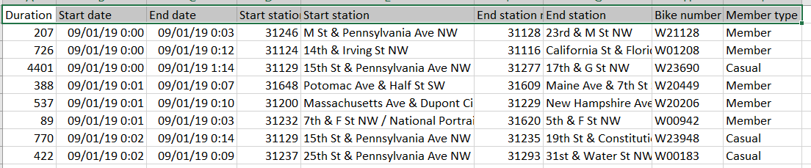
Data Description
Source of Data - https://www.capitalbikeshare.com/system-data
Bike data from September 2013 to September 2019
Holiday data - https://www.kaggle.com/gsnehaa21/federal-holidays-usa-19662020
Weather Data scraped from https://www.wunderground.com/history/daily/us/va/arlington-county/KDCA

Slide 4
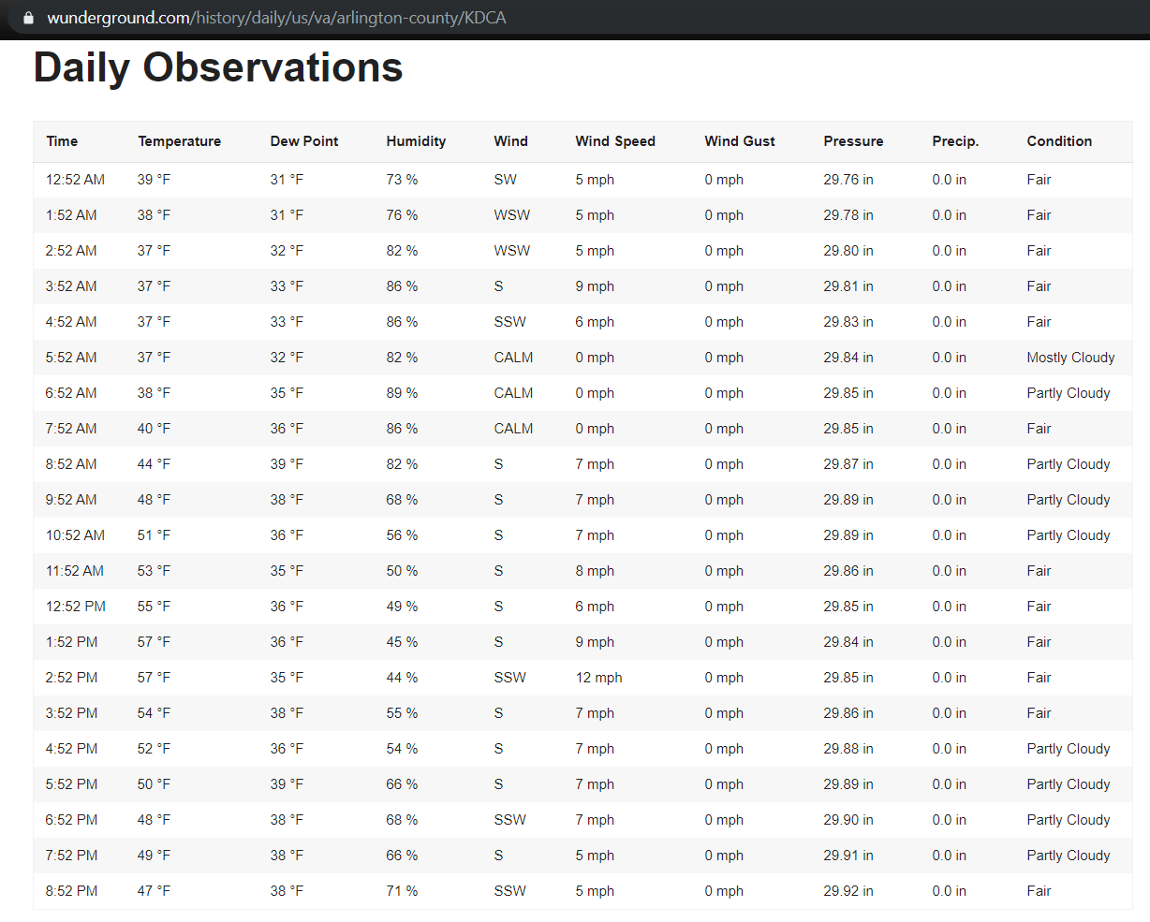
Data Description - Scraped Weather Data

Slide 5
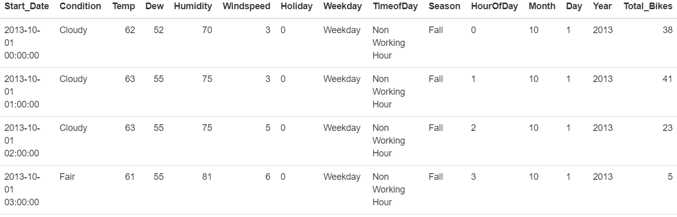
Data Preprocessing
Aggregated data per hour irrespective of start station, thus reducing 6 million records to 52k rows.
Condensed Weather Condition column from 47 levels to 6 levels mainly – Cloudy, Fair, Fog, Rain, Snow, Windy.
Using lubridate package we added HourOfDay, Year, Month, Day.
Final Dataset:

Slide 6
EDA
[Exploratory Data Analysis]

Slide 7
Exploratory Data Analysis
SMART Question – What is the total number of bikes rented at a given hour, temperature and season?
We look at the variables like season, temperature, hour of day, and the correlations of these variables with bikes rented

Slide 8
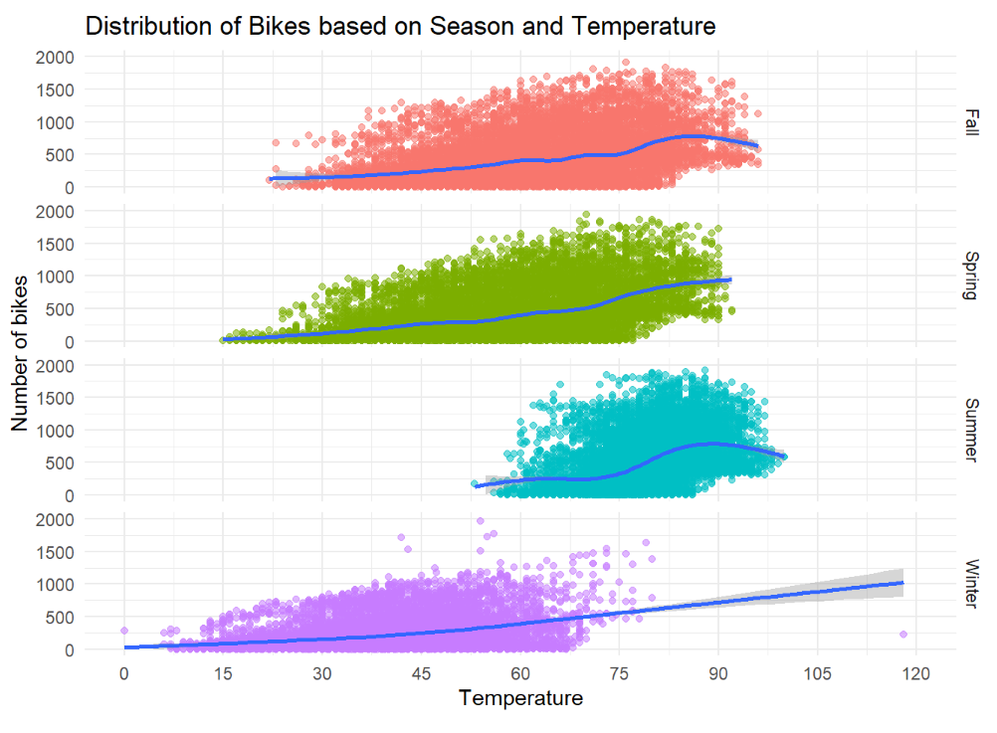
Season and Temperature
Bikes rented more during fall, summer and spring
Number of bikes rented is maximum between temperatures from 80-90F

Slide 9
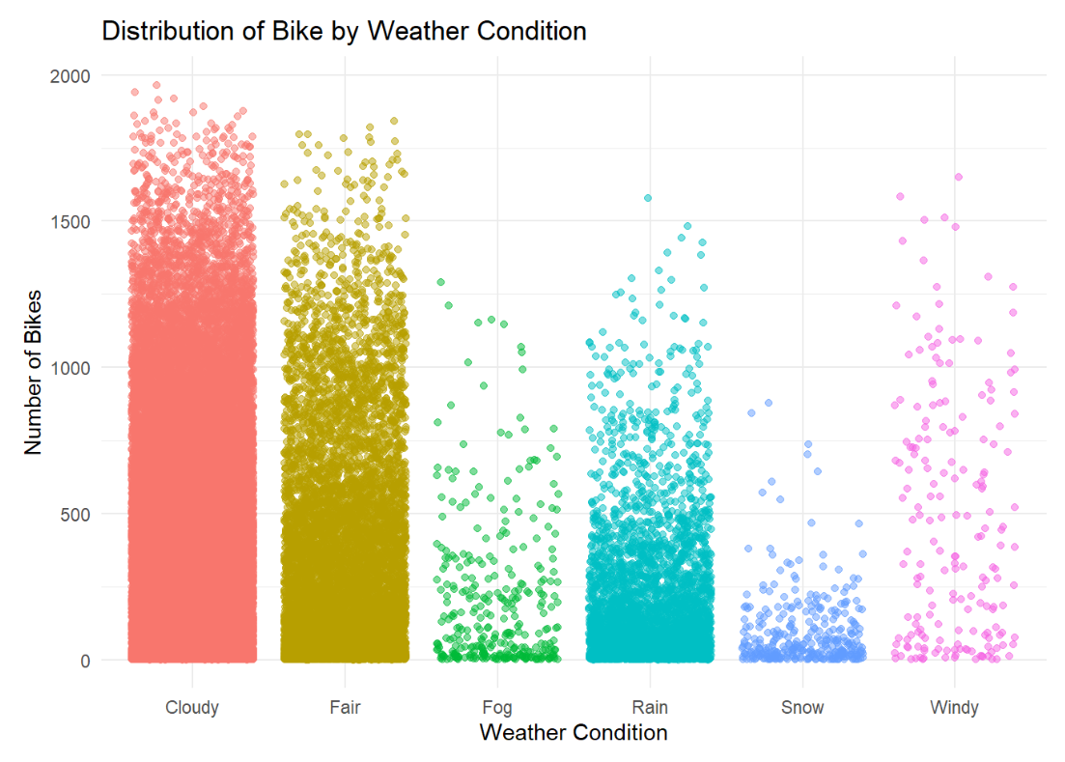
Weather Conditions
Bikes rented most during cloudy and fair weather
Least during windy and foggy conditions

Slide 10
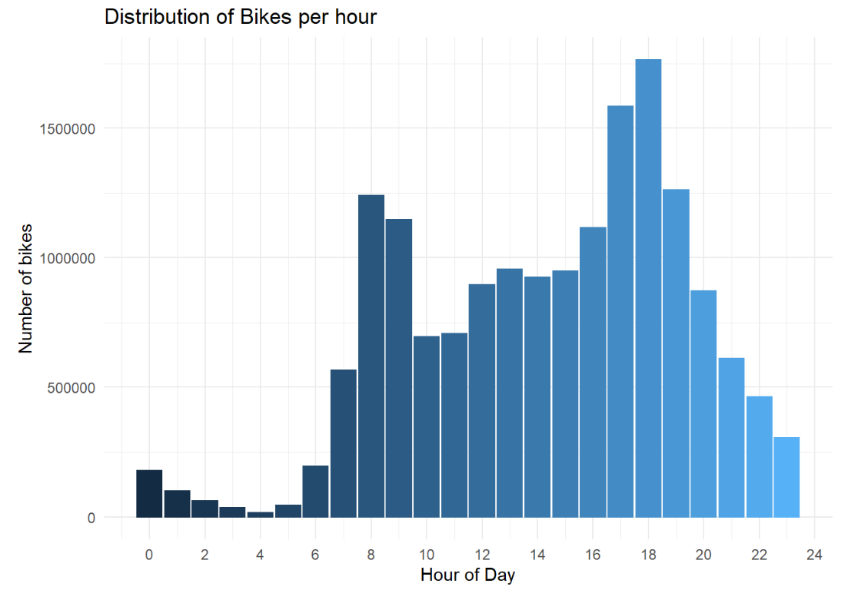
Hour of Day
Bikes rented peak at morning 8AM and evening 6PM

Slide 11
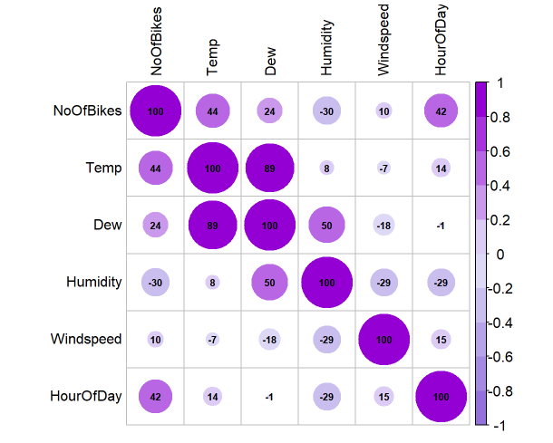
Correlation between bikes hired and weather variables
Bikes rented are positively related to temperature and hour of day
Negatively related to humidity

Slide 12
Modelling

Slide 13
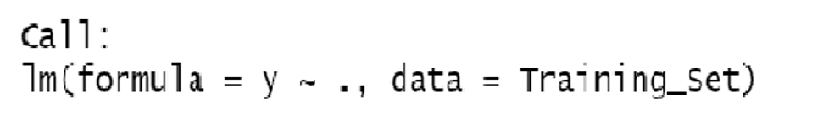
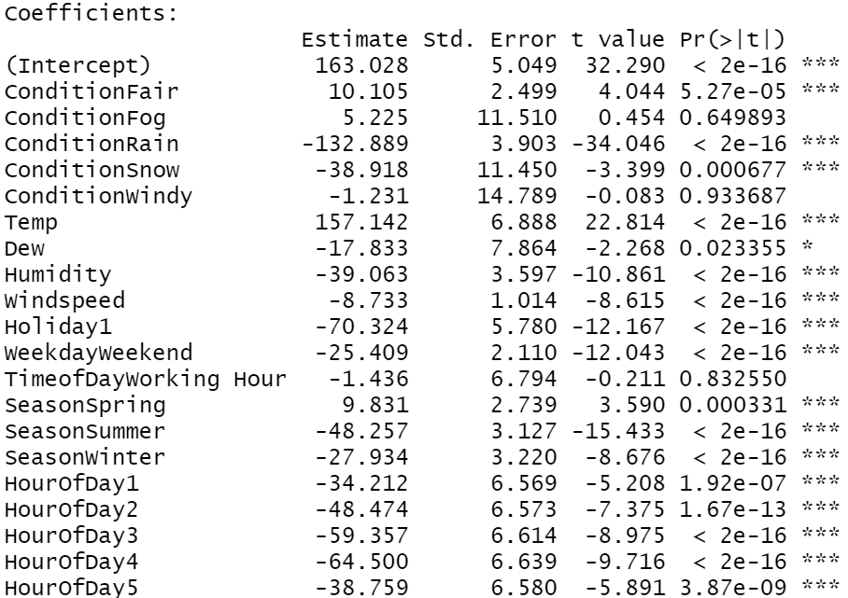
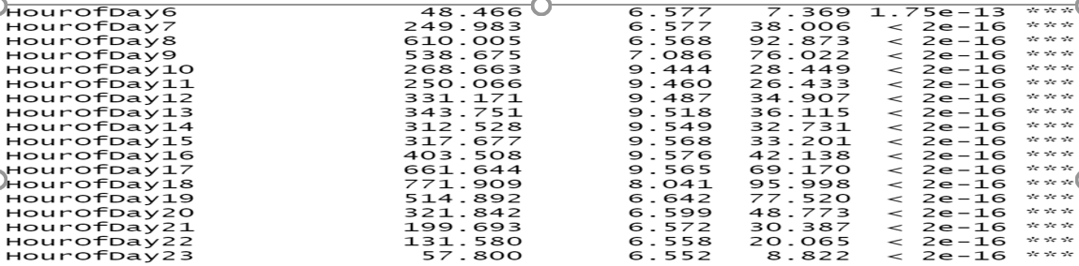
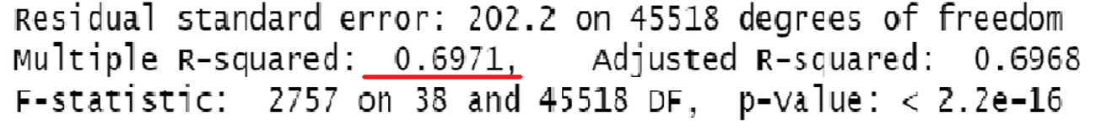
Linear Model with all Features
Model

Slide 14
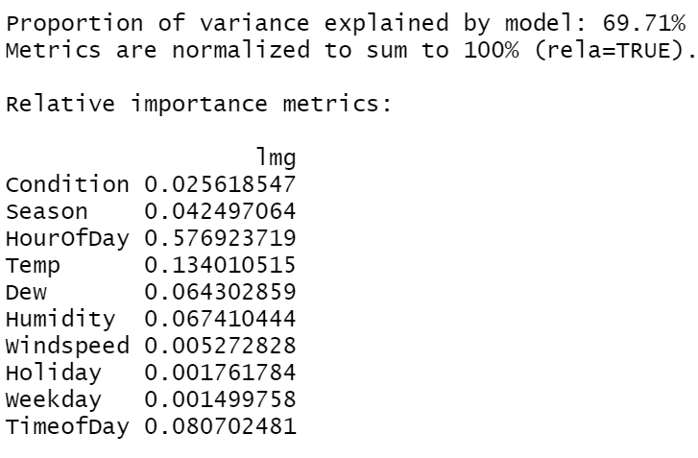
Relative Importance Metrics

Slide 15
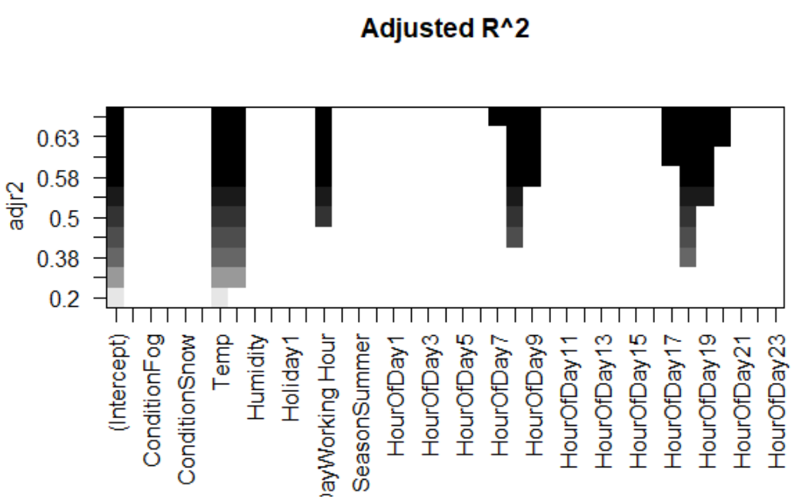
Feature Selection – Forward Method

Slide 16
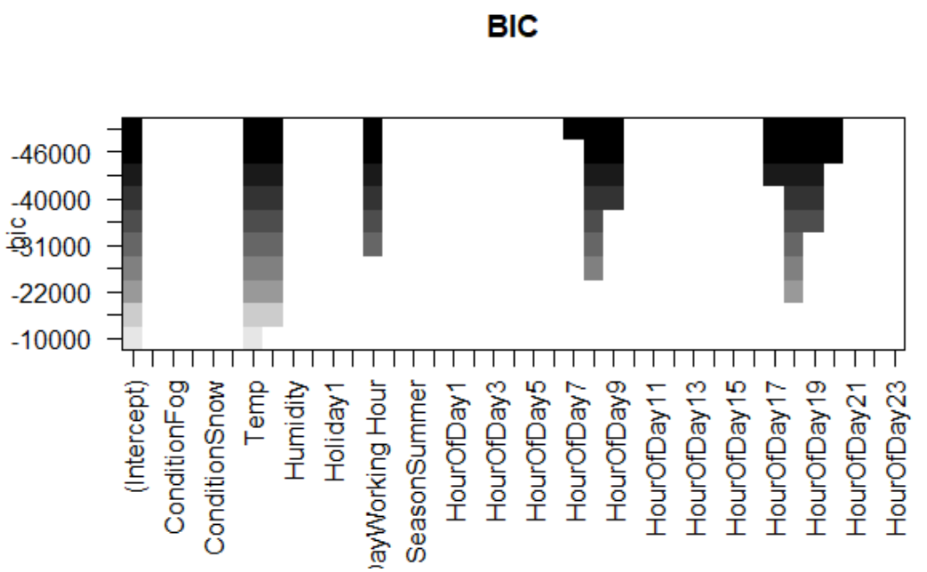
Feature Selection – Forward Method

Slide 17
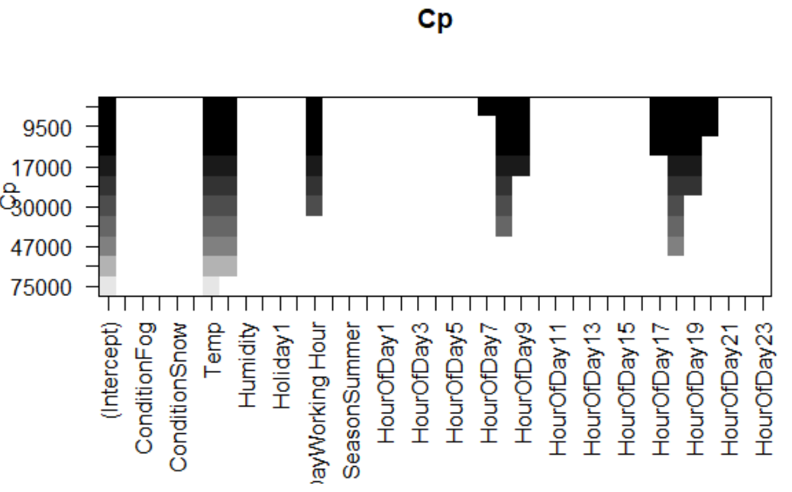
Feature Selection – Forward Method

Slide 18
Linear Regression Model
Full Model:
Full Model Adjusted R Squared:
Total Number of Model Comparison : 2 ¹⁰

Slide 19
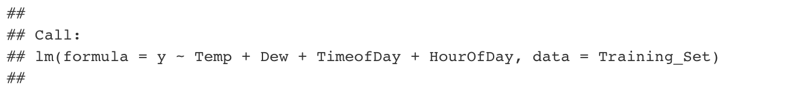
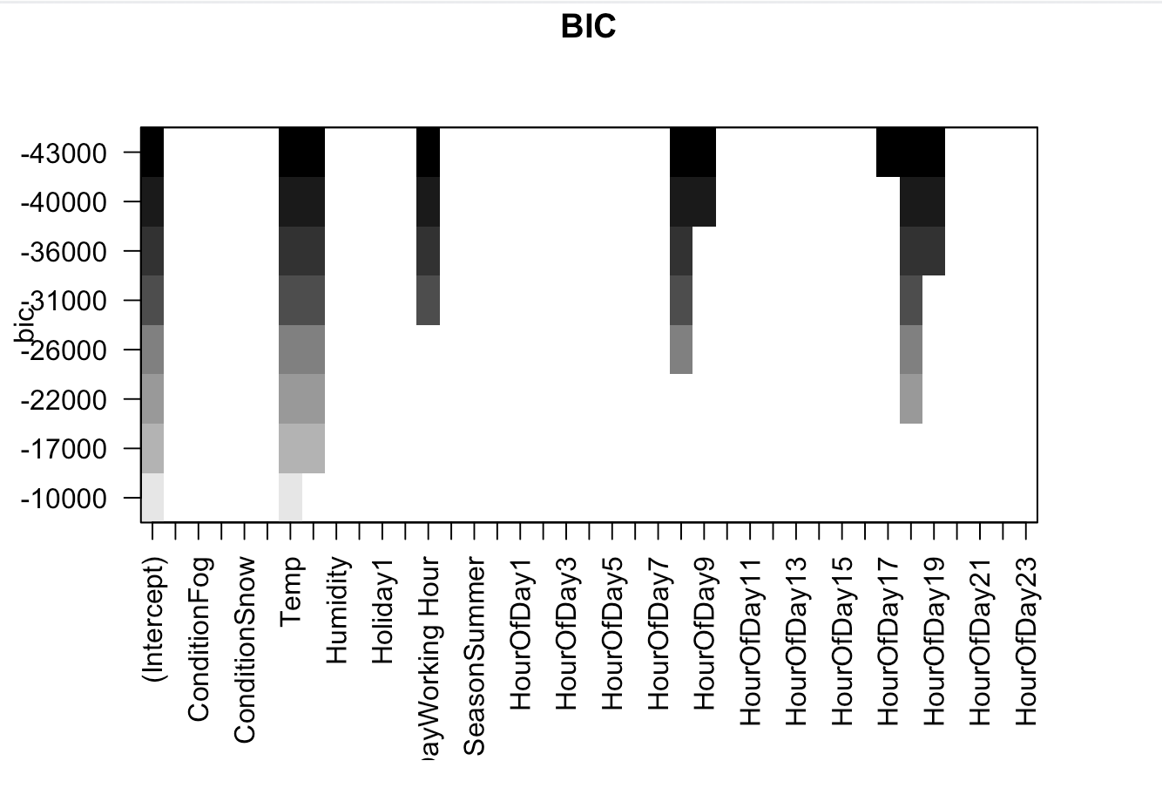
Linear Regression Model – Variable Selection
Full Model:
Reduced Model:

Slide 20
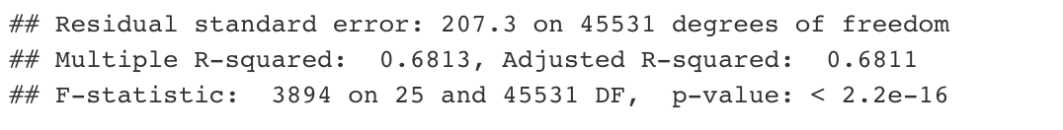
Linear Regression Model – Variable Selection
Full Model:
Reduced Model:

Slide 21
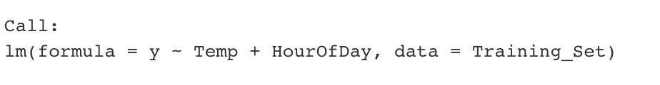
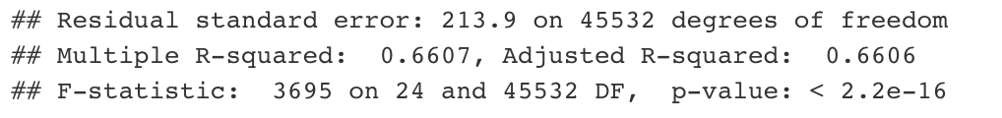
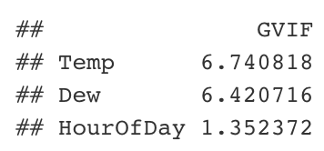
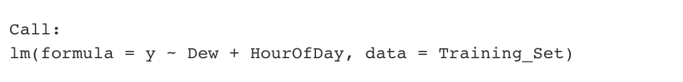
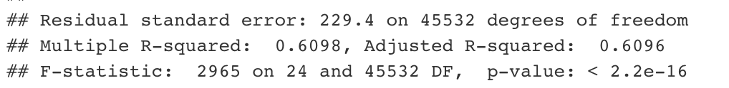
Linear Regression Model - Collinearity
Final Model

Slide 22
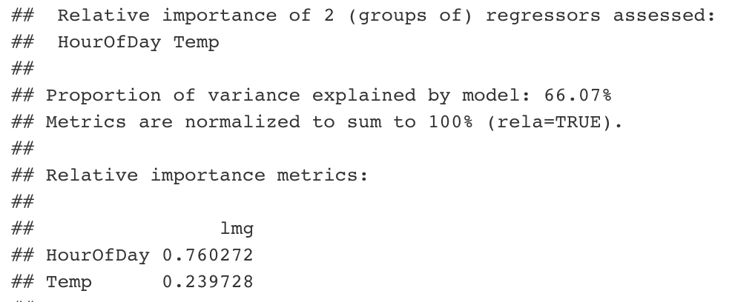
Linear Regression Model – Relative Importance

Slide 23
Regression Decision Tree
Decision Tree can be used for regression problem
Works for non-linear data and are simple to create
Caret Package interface provides “rpart2”, which tunes the model based on maximum depth of the tree.
Here we have used 10-Fold cross validation and repeating it 3 times.
We have set the tuneLength = 9

Slide 24
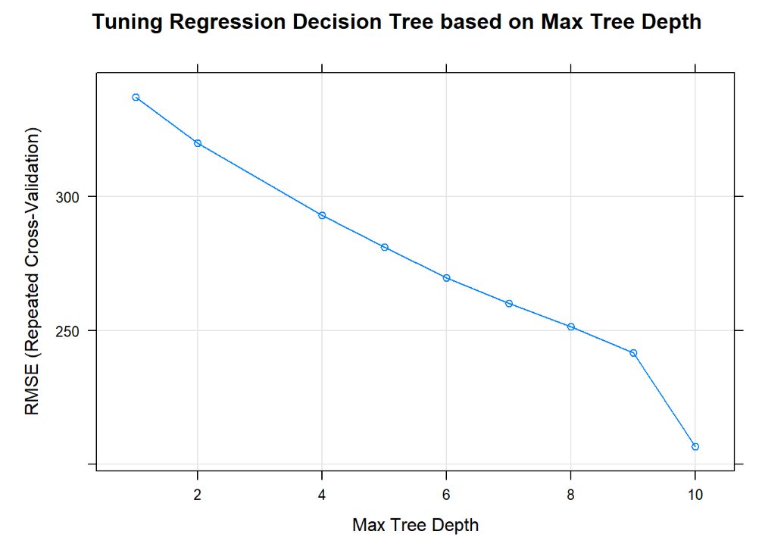
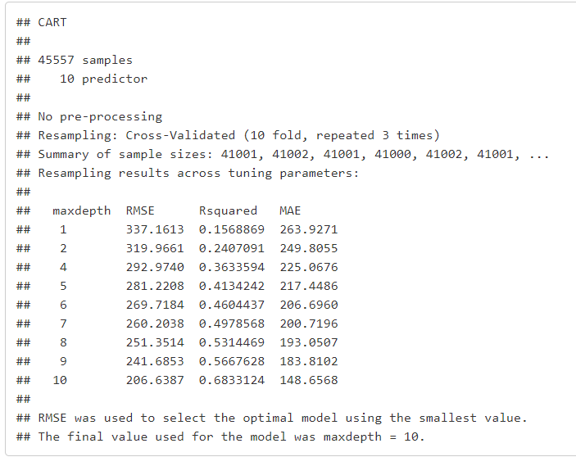
Regression Decision Tree

Slide 25
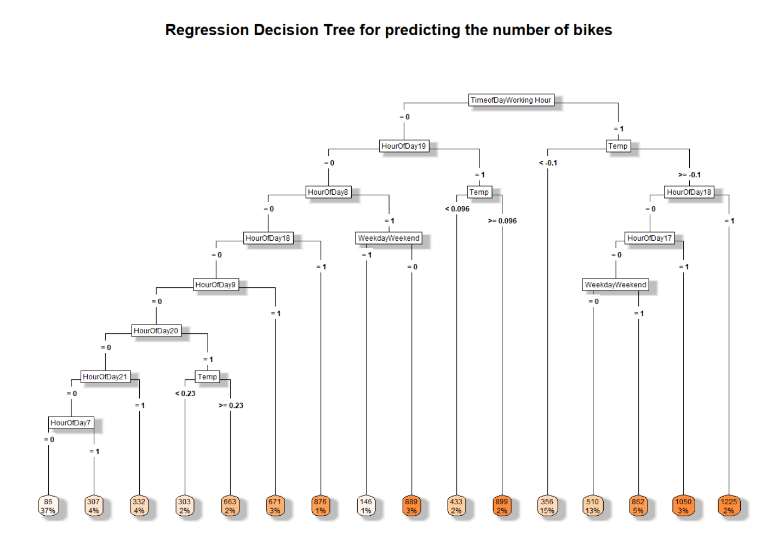
Regression Decision Tree – Best Model

Slide 26
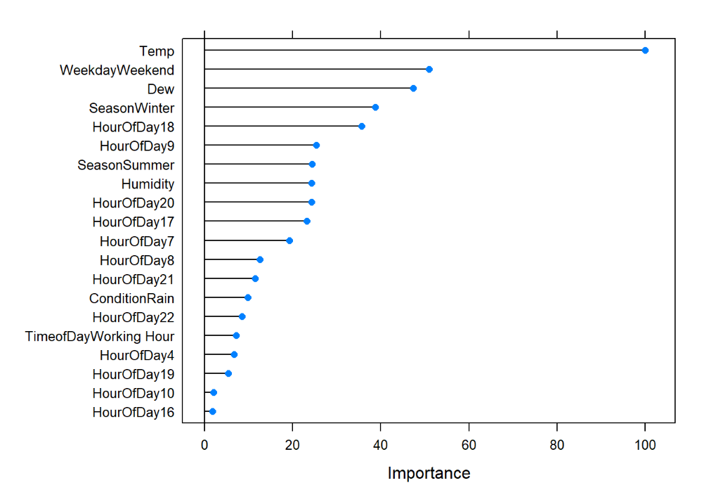
Regression Decision Tree – Variable Importance

Slide 27
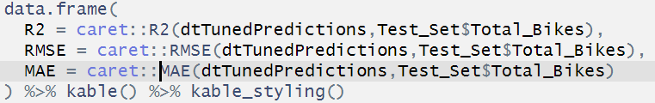
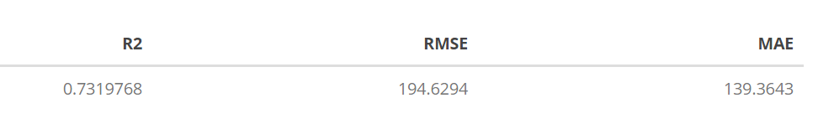
Regression Decision Tree – Test Data Evaluation
Prediction:
Evaluation Metric:
Metric Values:

Slide 28
Bagged Decision Tree
Decision Tree have a drawback, they are not flexible and perform poorly with a new sample of data.
Bagging = Bootstrapping Data + Aggregation
Bagged Decision Trees creates an ensemble of decision trees.
Bagged Decision Trees overcome the drawback of Decision Trees by estimating the value based on majority or averages.
Caret Package interface provides “treebag” for computing bagged decision trees.

Slide 29
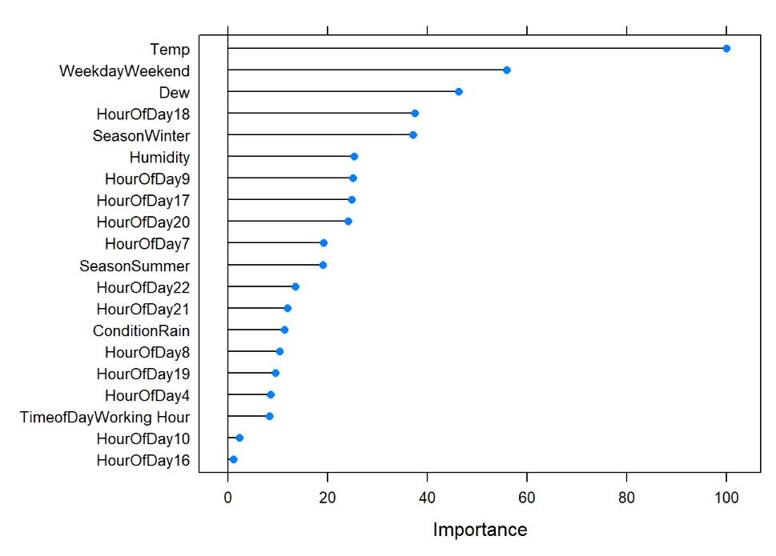
Bagged Decision Tree – Variable Importance

Slide 30
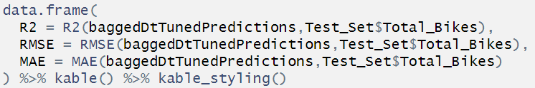
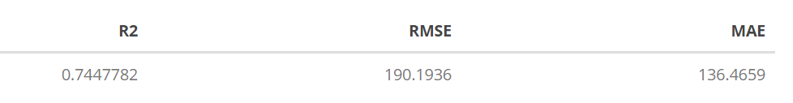
Bagged Decision Tree – Test Data Evaluation
Prediction:
Evaluation Metric:
Metric Values:

Slide 31
Bagged vs Regression Decision Tree – Metric Evaluation
Bagged DT
Regression DT

Slide 32
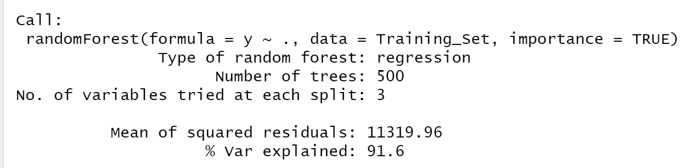
Ensemble Method – Random Forest
Random Forest:
Decision trees overfit models and works on single sample of data
Ensemble algorithm – creates multiple decision trees with different samples and variables, then combine output generated each tress – increases predictive power of model
Default Random Forest Method : ntrees – 500 mtry – 3
Mtry – Number of random predictors used each samples
classification – sqrt(n) and Regression – n/3

Slide 33
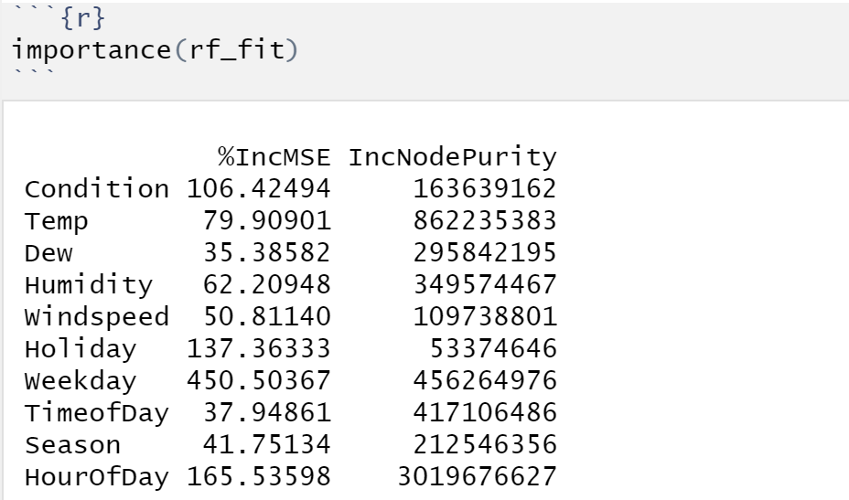
Random Forest – Variable Importance
Variable Importance:
%InMSE – Mean Decrease Accuracy
- How much model accuracy decreases if we leave out that variable
IncNodePurity – Mean Decrease Gini
- Measure of variable importance based on gini impurity index used for the calculating the splits in tree
Important variable – HourOfDay, Weekday, Holiday, Condition, Temp

Slide 34
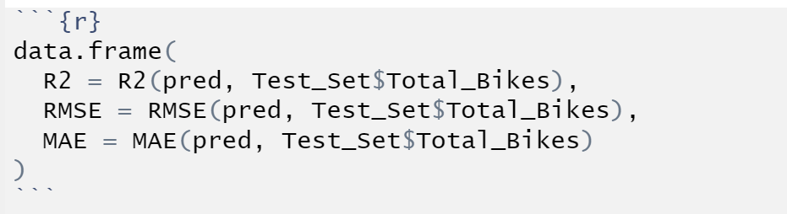

Random Forest – Test data Evaluation
Prediction:
Metric Evaluation:

Slide 35
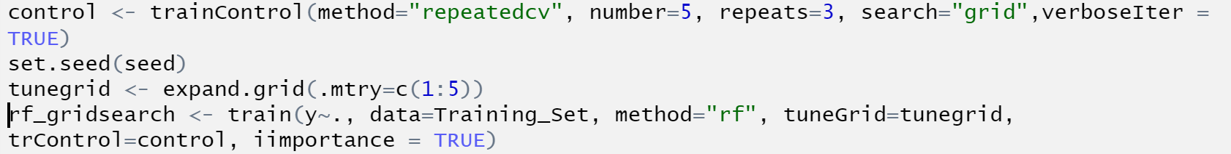
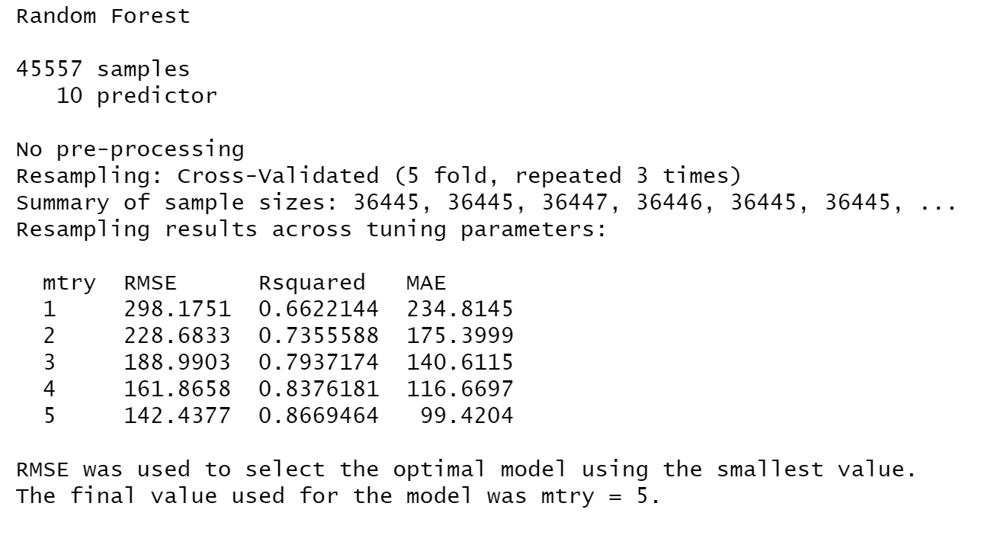
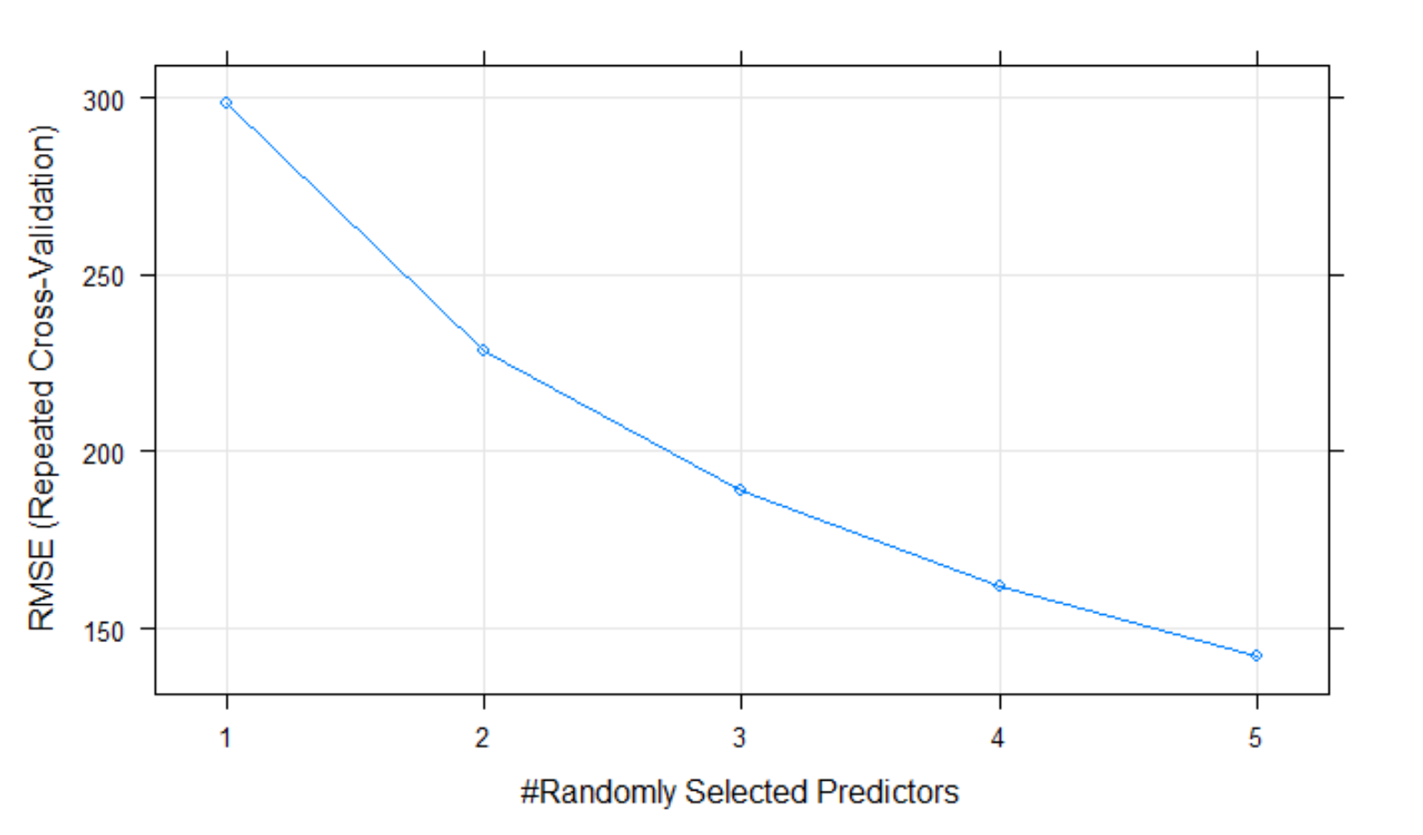
Random Forest – Grid Search
Grid Search – Random Forest
5-Fold Cross validation combinations with three repeats for combinations from 1 to 5

Slide 36
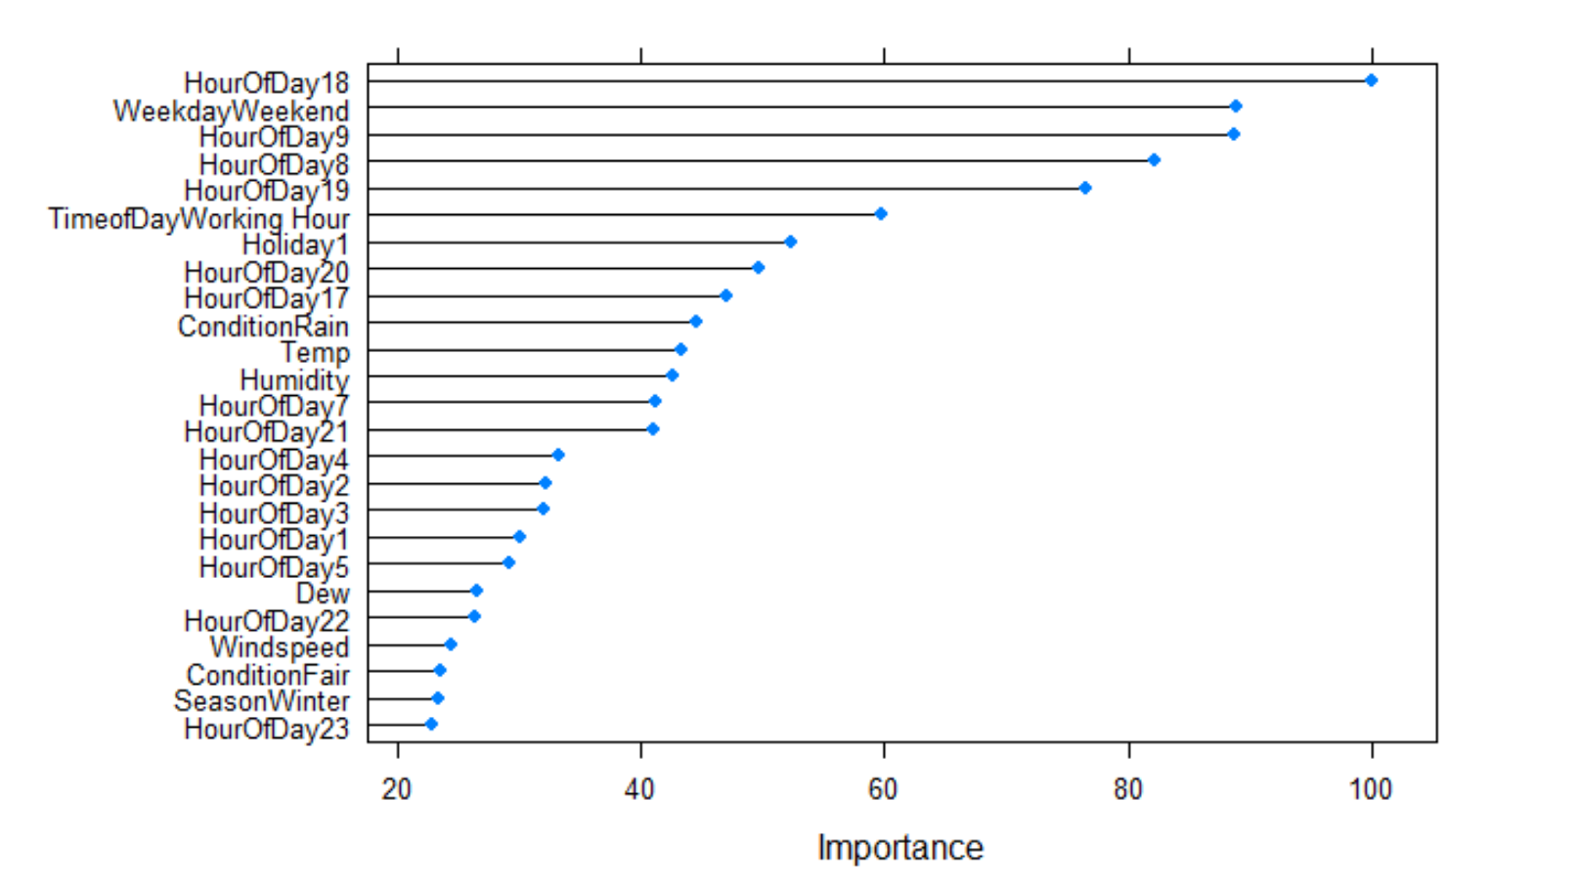
Random Forest Grid Search – Variable Importance
Variable Importance:
Important variable – HourOfDay, Weekday, Holiday, Temp

Slide 37
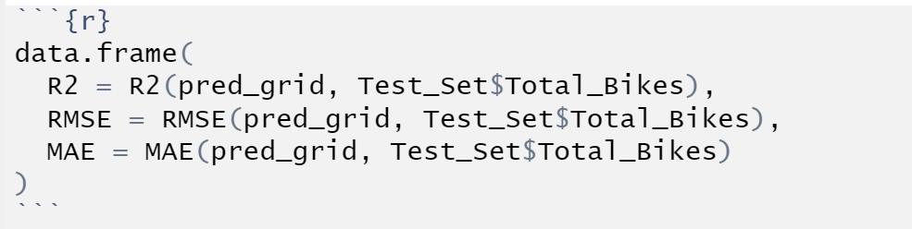

Random Forest Grid Search – Test data Evaluation
Prediction:
Metric Evaluation:

Slide 38
Comparative Analysis
Model | No. of Predictor | R2 [Test Data] | Variable Importance(desc)
Linear Regression | Full Model[10] | 0.69 | HourOfDay, Temp, TimeOfDay
Linear Regression | 2 | 0.67 | HourOfDay,Temp
Decision Tree | Full Model | 0.73 | Temp, Weekday, Dew, Season, HourOfDay
Bagged Tree | Full Model | 0.74 | Temp, Weekday, Dew, HourOfDay, Season
Random forest | 3 | 0.93 | HourOfDay, Weekday, Holiday, Condition, Temp
Random Forest – Grid Search | Combinations 1 to 5 with 5-fold cross validation 3 repeats | 0.88 | HourOfDay, Weekday, Holiday, Temp, Holiday

Slide 39
Conclusion
Modelling & Predictions:
- Random Forest works best with given dataset
- Maximum R2 value obtained is 0.93
- Variable Importance – Hour of day, Weekday, Time of day, Temp
Hour of Day – Best 6PM-7PM,8-9AM
Weekday – Weekend
Time of Day – Working Hour
Temp – Moderate Temperature – 70–90F
Insights:
- Normal day - Users use bikes for computation for office, school, etc
- Weekend & Holidays people prefer to use bikes for travel purpose
- Bikes are preferred maximum in moderate temperatures, users tend to avoid bikes at high temperature and low temperature.
Recommendation:
High demand on morning and evening office hours and weekend/holiday – increase availability during these hours – No of users increases, Profit is increased

Slide 40
Demo

